Slide 1
Information Technology for Indonesian Education Network
Computer Network Research Group
Institute of Technology Bandung
cnrg@itb.ac.id
http://xxx.itb.ac.id/~cnrg/

Slide 2
Focus
Existing Implemented Infrastructure.
Experience in Building an AII.
Low Cost Technology To Educate Indonesia.
Low cost is the real challenge

Slide 3
Our situation
Develop by University
Implemented & Run by Education Sector
For Indonesia ….

Slide 4
Outline
Historical Perspective
Current Infrastructure.
Brief overview on our research results in:
  physical layer.
  Network layer.
  Application layer.

Slide 5
Experience in Internet building
January 1993 - Suryono (Texas) install a packet radio 1200bps to LAPAN.
LAPAN 1200bps to BPPT & Internet 64Kbps.
286 PC as gateway! to connect the whole ITB campus.
Software NOS (running on DOS) as gateway.

Slide 6
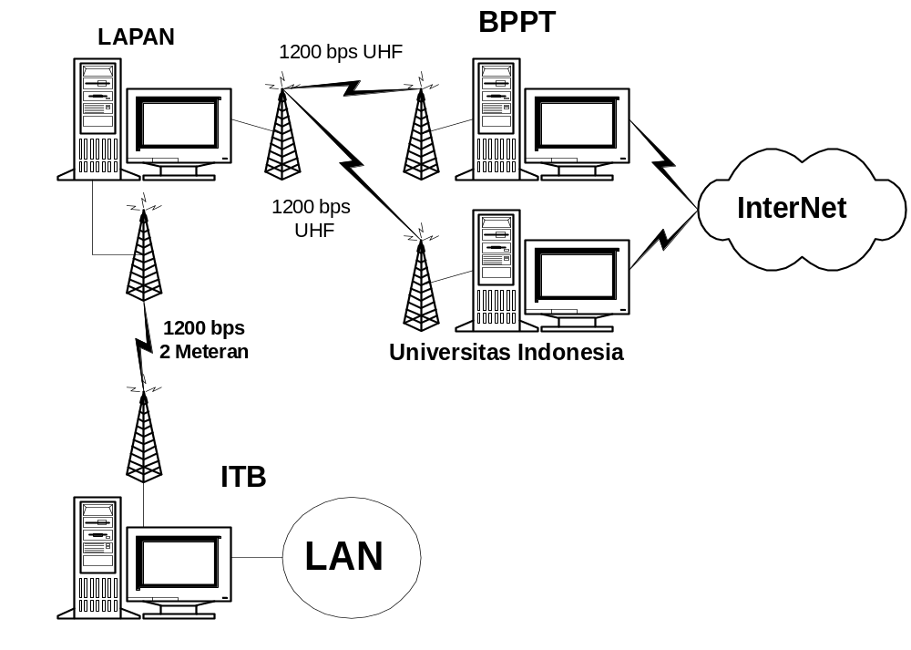
Indonesia Topology Jan.1993
Amateur Packet Radio AX.25
at 1200bps
Starts from simple equipment
We grow the community
PC Gateway 286!

Slide 7
ITB in 1995
Telkom Leased Line at 14.4Kbps
RISTI-Telkom to BPPT 64Kbps.
ITB uses FreeBSD (UNIX) as Router & Server.
For the first time ITB sees Web in Internet.
ITB learns to build a campus network (how to handle the lightning).

Slide 8
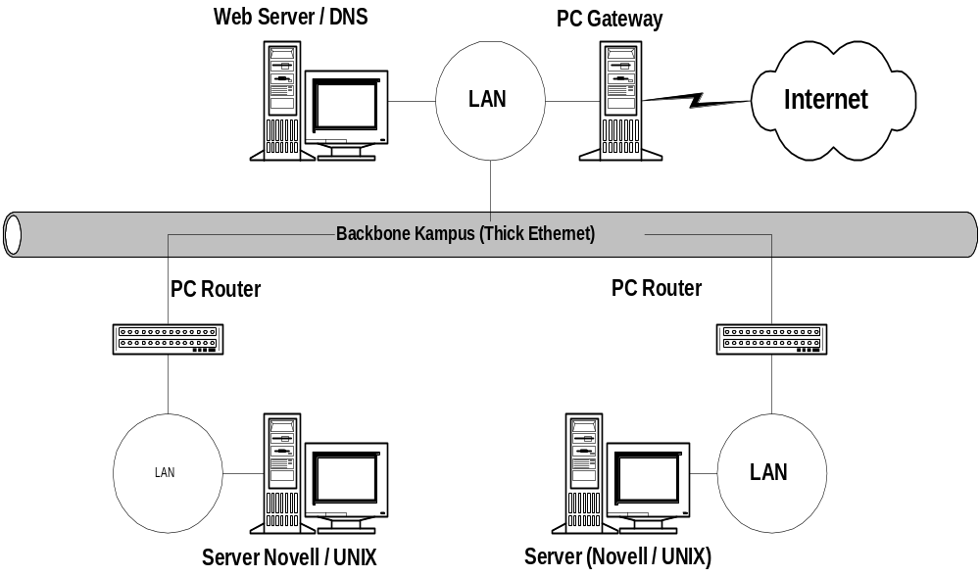
Typical ITB Campus Net

Slide 9
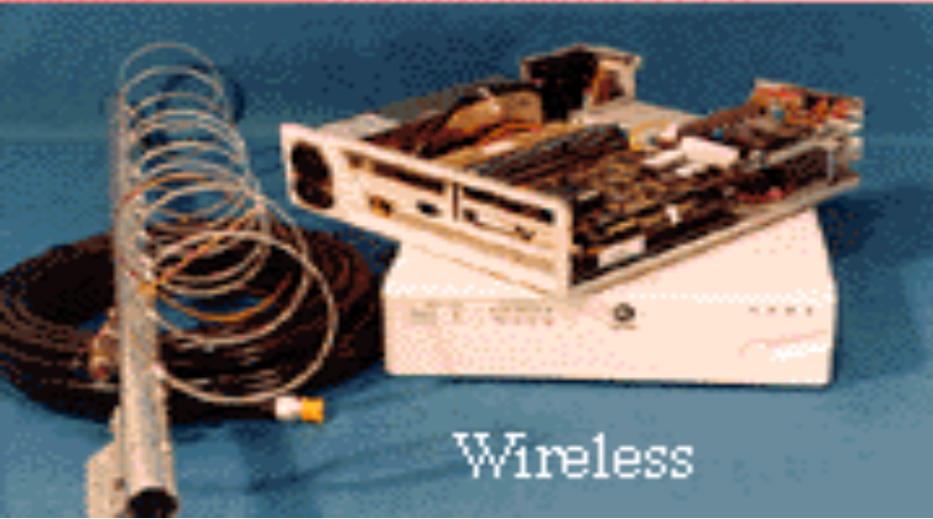
ITB Today ....
T1 Satelite link to Japan.
2Mbps link to Indonesia IX.
VSAT TDMA & SCPC to various universities.
4Mbps Uwave Jakarta-Bandung.
128 Kbps to Jakarta, Surabaya & Malang.
WaveLAN 2Mbps for Metropolitan Area Network (MAN).

Slide 10
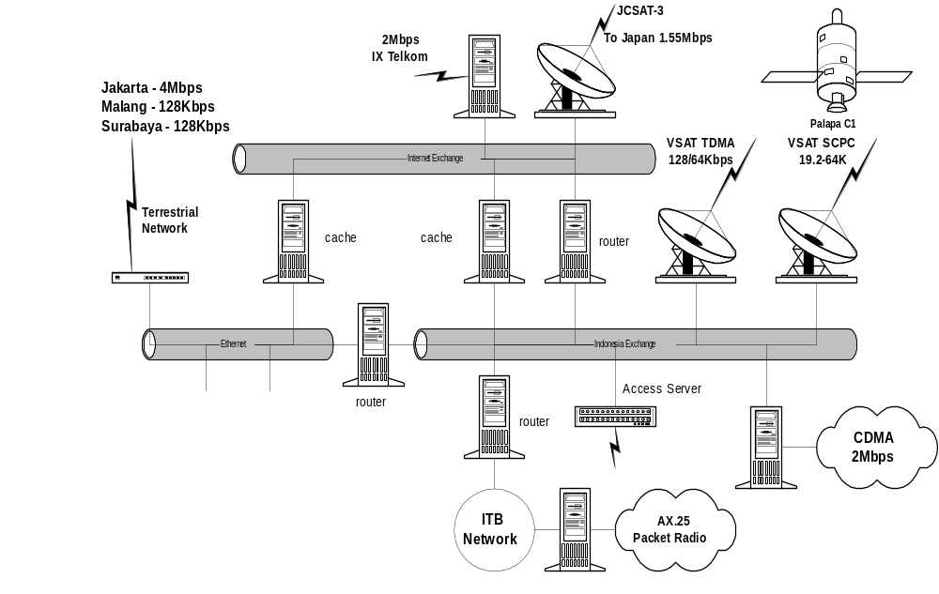
ITB Network Operation Center

Slide 11

Connection to
IIX via RadNet
Connect to 6 Universities
5 Universities / Research Inst
7 Universities via
VSAT TDMA
SCPC
Connect 3 Universities
> 10 educational institutions

Slide 12
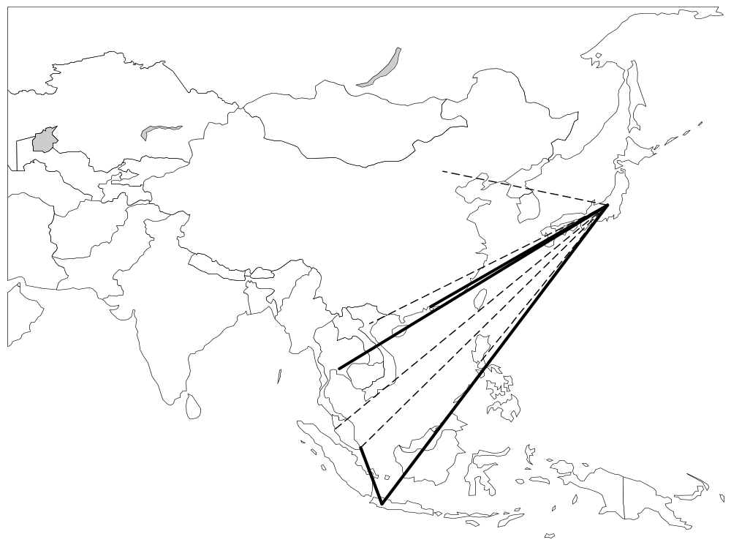
AI3 is currently connecting
Japan, Thailand, Hongkong &
Indonesia
Additional 30 Mbps Link as part of
Asia Multimedia Forum supported by NTT
is on negotiation processes
Work is underway to link
Malaysia, Singapore, Phillipine,
Vietnam, China, Cambodia
JCSat-3 is used as the main
Satellite link
Indonesia has 2 major links
1.5 Mbps to Nara (JCSat-3)
19.2 Kbps to TP, Singapore
NAIST, Nara, Japan
AI3 Hub

Slide 13
Asia Internet Interconnection Initiatives (AI3)
Homepage:
  http://www.ai3.net/
Contact Persons:
  Prof. Suguru Yamaguchi (suguru@wide.ad.jp)
  Prof. Jun Murray (jun@wide.ad.jp)
Major mailing lists:
  ai3@wide.ad.jp
  ai3-partners@wide.ad.jp
  ai3-staff@wide.ad.jp

Slide 14
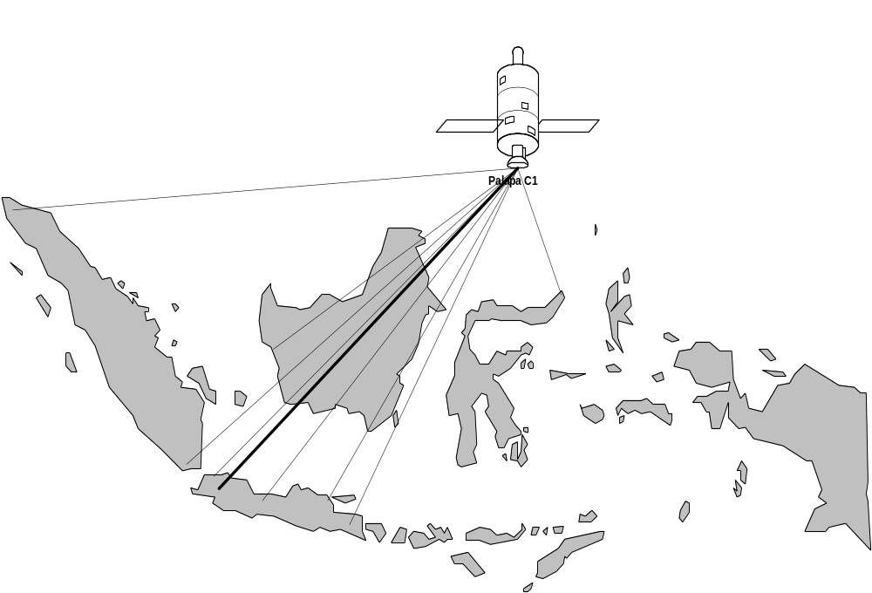
A huge challenge to network
1300 universities & 10.000+ high schools
Palapa C1 is used as one
of the main satellite link

Slide 15
Key to Success
Involving students
in the process!
Gives incentives
for education!
The more people
the lower the cost
Human Resource Development!
Self-financing!
Community-base development.

Slide 16
Philosophy behind the action

Slide 17
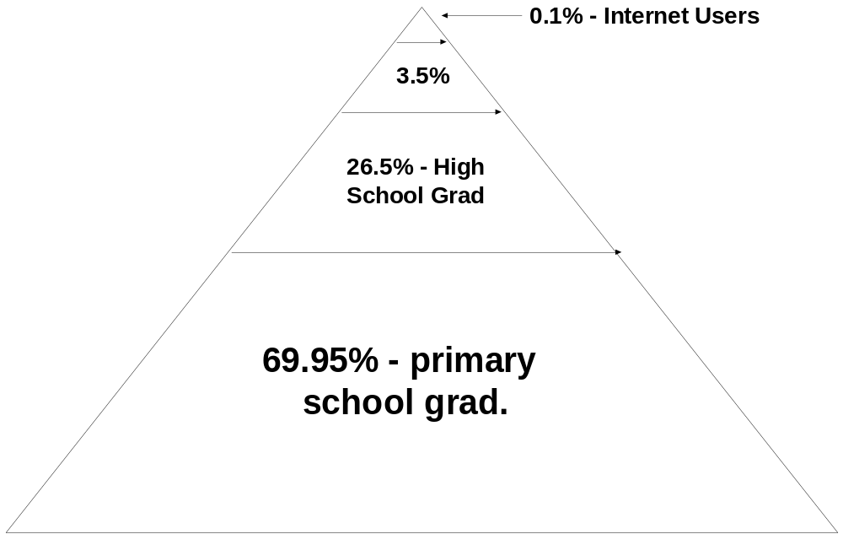
Indonesian Work Force by Education
82 Million Total Work Force

Slide 18
Vision ..

Slide 19
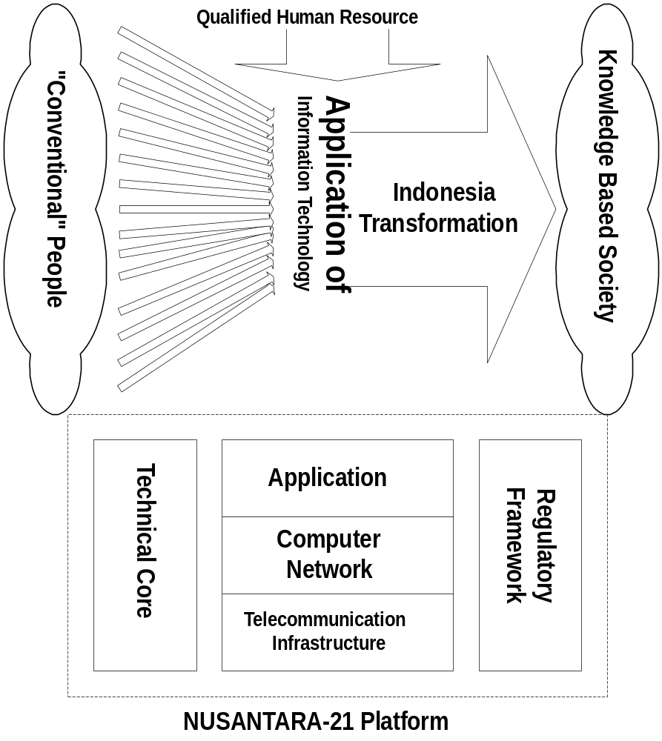
Mass of Qualified
Human Resource is a must
A National Information Infrastructure
is the Vehicle
Several IT Applications Will Be Used
To Initiate The Transformation
Transform the Indonesian People into
Knowledge Based Society

Slide 20
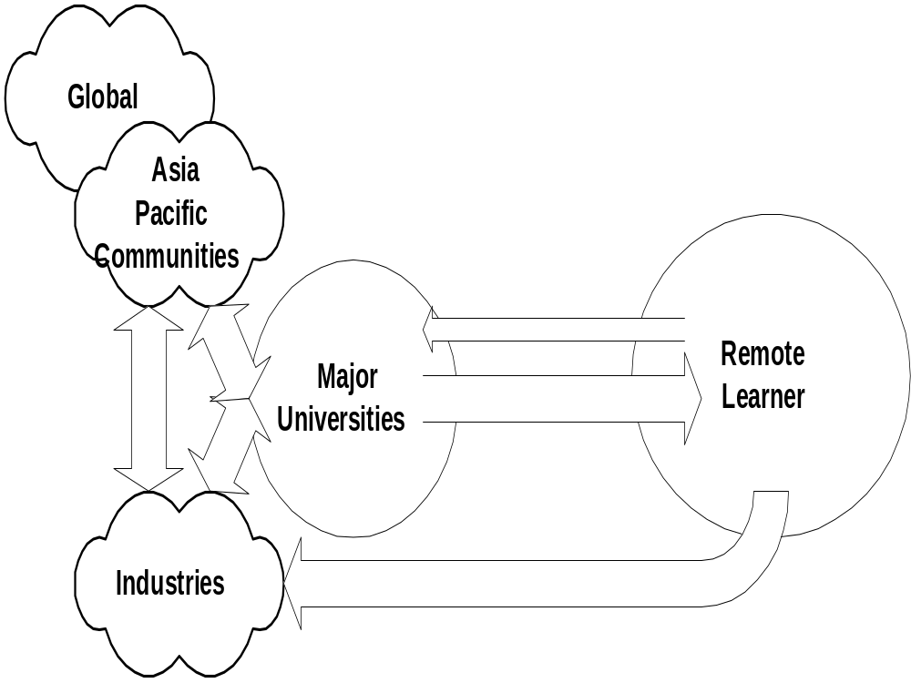
Make Others Knowledgeable
They will then build the economy
To do so ….
collaborate with global society

Slide 21
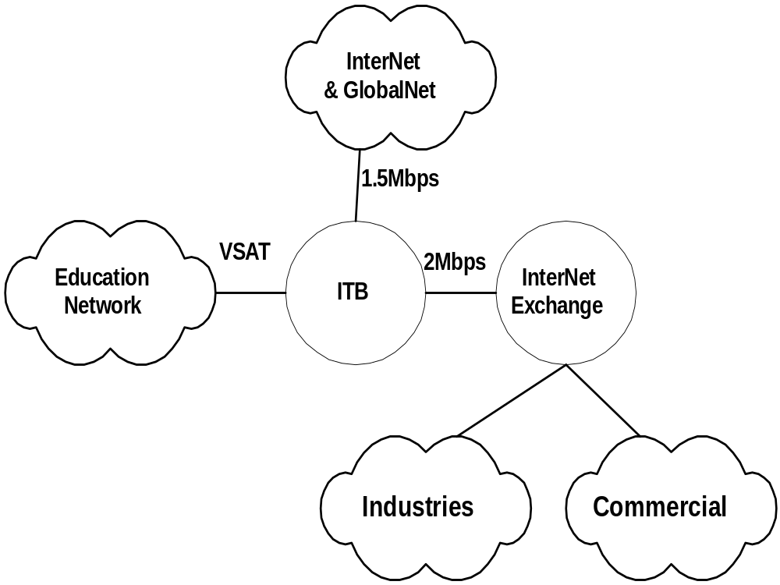
2 Mbps to Indonesia Internet Exchange
20+ Educational Institutions
via VSAT, WaveLAN etc.
To reach the economics sectors
1.5 Mbps via AI3 (WIDE, Japan)
19.2 Kbps via TP, Singapore

Slide 22
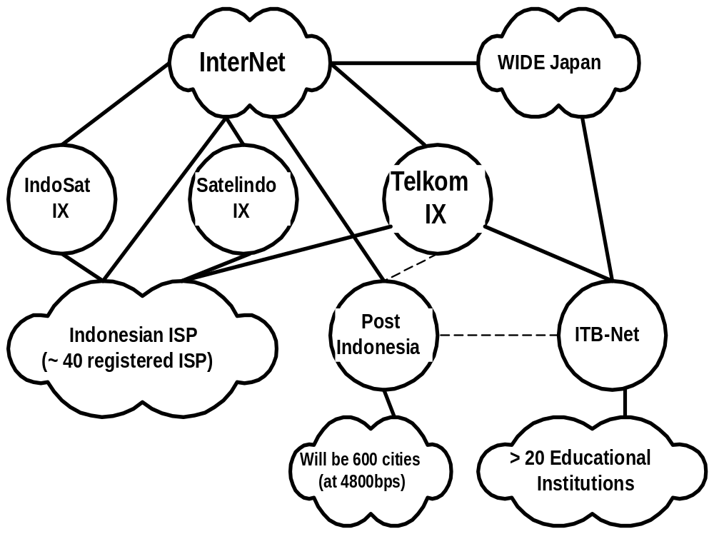
> 20 Mbps
No Government Subsidy
No Government Incentive
Self-finance
Self-manage

Slide 23
Results in Physical Layer
Homebrew 2Mbps CDMA.
VSAT TDMA vs. SCPC Network.
Low Cost Access for Schools.
Internet Access for Amateur Radio

Slide 24
VSAT TDMA vs. SCPC
VSAT TDMA 128Kbps Outbound
VSAT TDMA 64Kbps Inbound
VSAT TDMA is not suitable for Internet application (especially Web).
Tune TDM for 40 byte (originally 256byte packet).
Migrate to VSAT SCPC (min) 19.2Kbps.

Slide 25
Homebrew 2Mbps CDMA
Uses Lucent CDMA 2Mbps card 915MHz 250mW.
Run on FreeBSD.
Homebrew antenna (cost ~US$150).
Max. distance 15km (use PA for more).
Most of our high speed MAN using this technology.

Slide 26
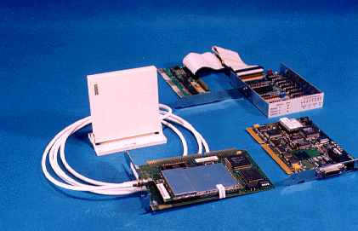

Slide 27
Consequences CDMA 2Mbps
bypassing local line.
We promote different alternative for building high speed network.

Slide 28
Homebrew 64-256Kbps packet radio
We are prototyping 64-256Kbps packet radio network in the lab by adnan@itb.ac.id.
AX.25 link layer protocol is used.
GMSK MX 589 one chip modem is used.
We drive the modem via parallel port.
MMIC Minicircuit is being build for transverter.

Slide 29
Low Cost Access for Schools
AX.25 1200bps Packet Radio Network.
Proxy Server.
Dial on Demand for Web & Interactive Internet Access.

Slide 30
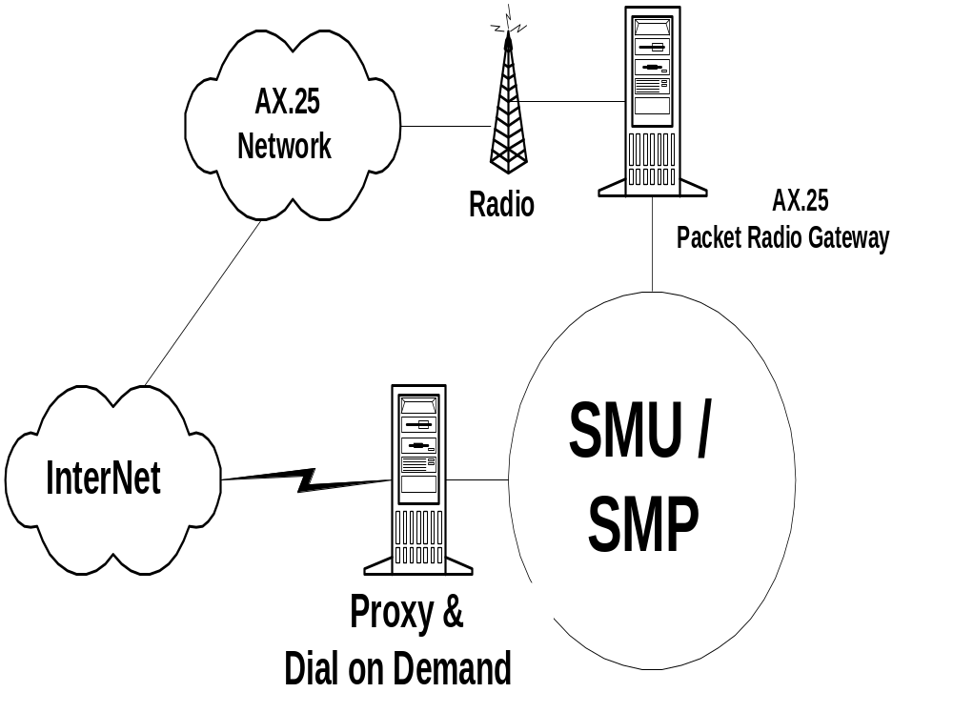
IntraNet for High Schools
24 hours
Packet Radio
E-mail
Proxy & Dial-on-Demand
for Web on Demand

Slide 31
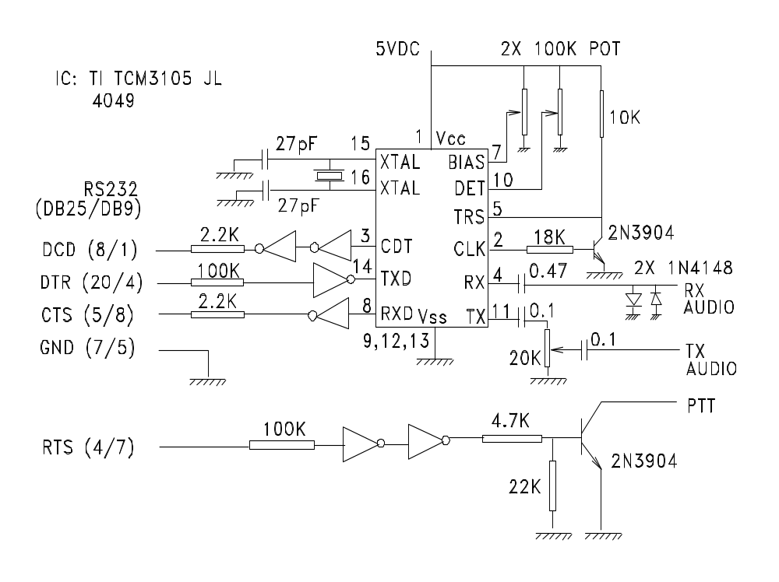

Slide 32
Soundblaster Modem
PC running Linux
Software Modem Packet Radio for Soundblaster
Connect SB-10 to Radio
Speed 1200-9600bps.

Slide 33
Amateur Radio Network
Jakarta
Bandung
Malang

Slide 34
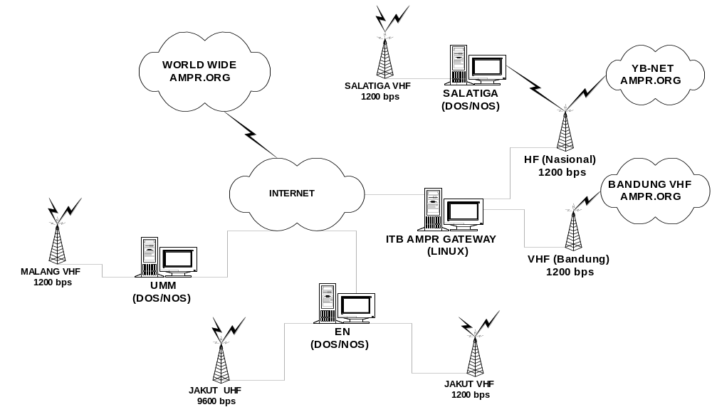
AMPR.ORG NET
ITB GATEWAY
UNIV. MUHAMMADIYAH
MALANG
YB2SV (JOS SOEJOSO)
SALATIGA
ELEKTRINDO
NUSANTARA

Slide 35
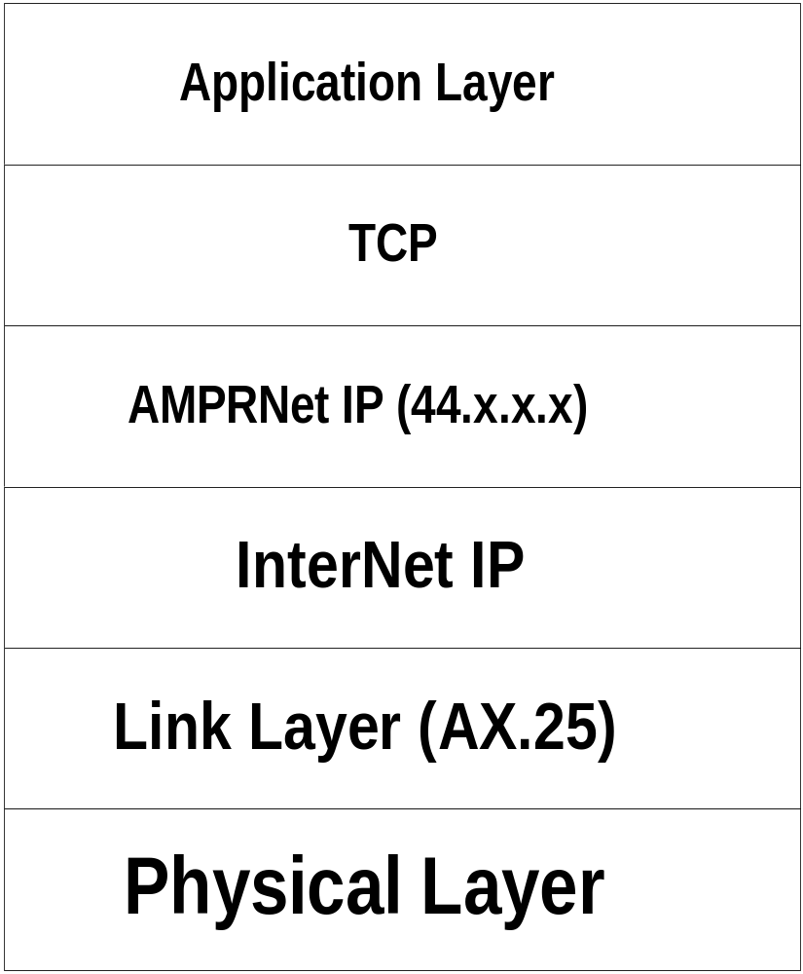

Slide 36


Mobile Computing

Slide 37
Results in Network Layer
Network Monitoring by ismail@cnrg.itb.ac.id.
Monitor at http://netmon.itb.ac.id/
  Network Map
  Sample of traffic by protocol, port, etc.
  Graph of total traffic.

Slide 38
Traffic Distribution Grapher
Describes:
Comparison between Inbound and Outbound Traffic
Traffic Distribution by Protocols
The Most Active Routers/Hosts by Protocols
Daily Usage Trend for some Protocols
Weekly Protocol Usage Trend

Slide 39
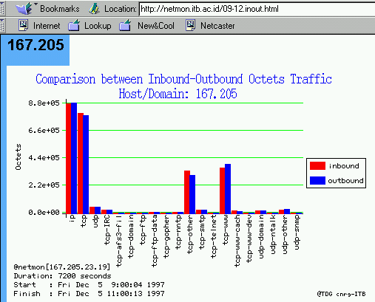
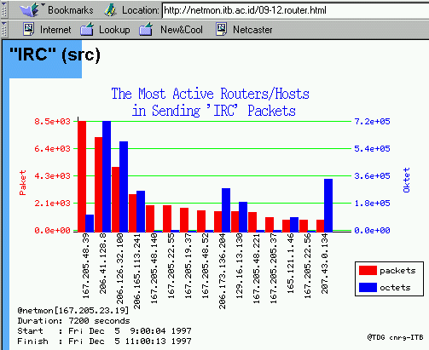
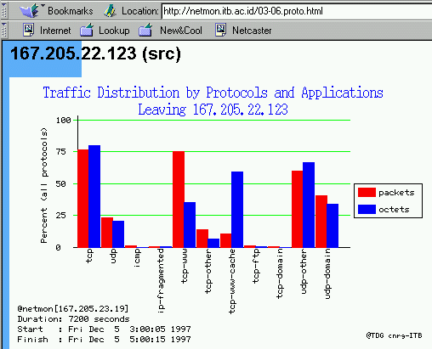
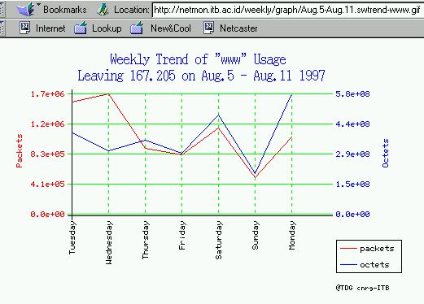
TDG
URL: http://netmon.itb.ac.id/
In vs Out
Host
Protokol
Trend

Slide 40
Benefits:
Behaviour of the users in ITB (AI3):
  Subjects of interest
  Sites to be visited
  The rush hours
  Most actives computer/host
Planning the traffic routing, firewalling, etc.

Slide 41
Network Monitoring
“Scotty & Map Generator”

Slide 42
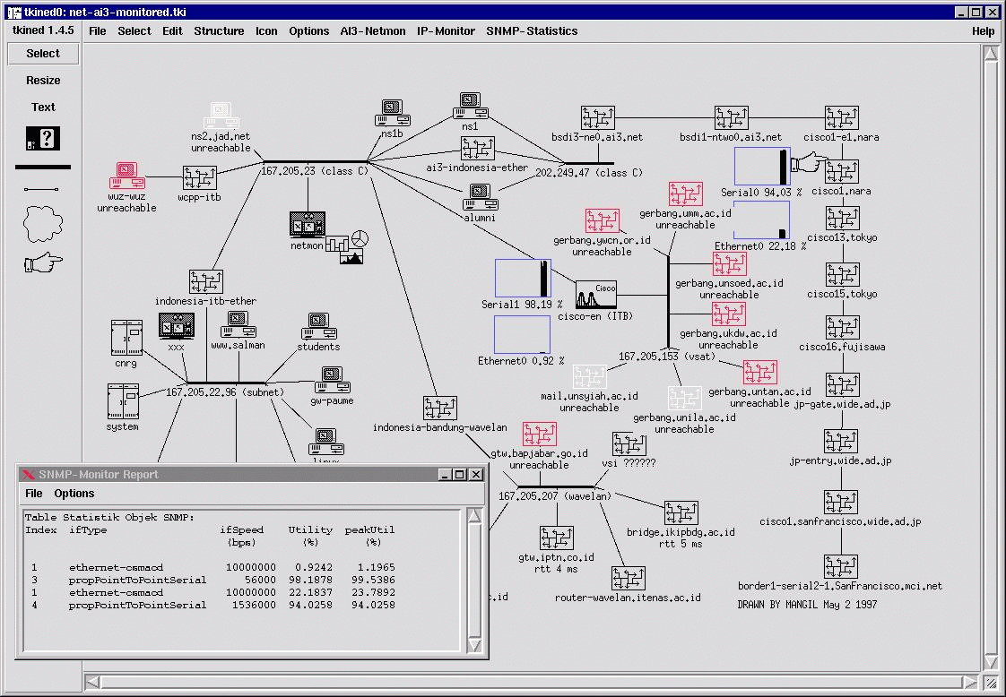
Scotty monitor
Connectivity
monitoring
Interface utility
monitoring

Slide 43
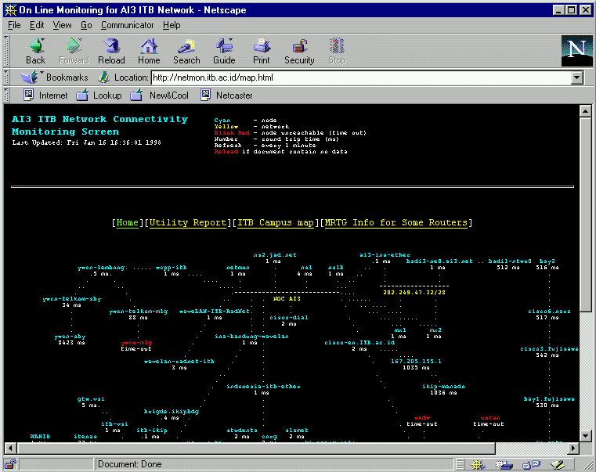
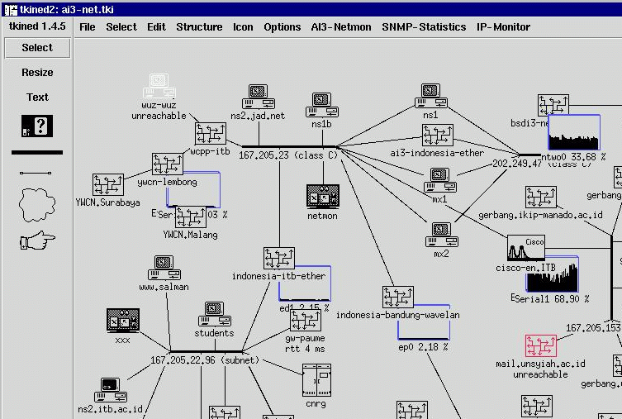
Web screen
Scotty monitor

Slide 44

http://netmon.itb.ac.id/map.html
Text Map
Web screen
Timeout alarm
E-mail to Administrator

Slide 45
http://netmon.itb.ac.id/map.html
Web screen
Interface Utility
Report

Slide 46
Results:
Reconfiguration of VSAT TDMA interface speed for better performance.
Monitoring the JAMUS (ITB-YWCN) link performance.
  To Lembong: 99.525 %
  To Surabaya: 85.523 %
  To Malang: 86.282 %

Slide 47
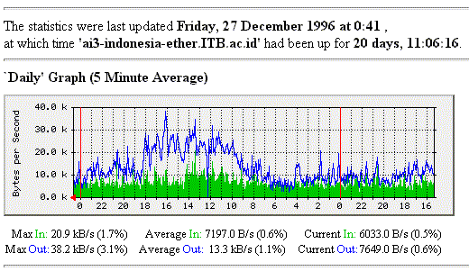

Slide 48
System Platform:
Pentium 100
16 MB RAM
2,1 GB Hard disk
Operating System: FreeBSD
Main Software: Scotty/Tkined (FreeWare) and TCPDUMP.
Under Xfree86 Windows

Slide 49
Results in Application Layer
Mailing Lists
English Technical Writting Course distance learning test bed.
Cache & Cache Monitoring.
MPEG-3 Test Bed.
RealPublisher & NetShow test bed.

Slide 50
Cache
ITB has set several Parents cache.
Cache person is husni@itb.ac.id
We cache all of our Web traffic.
check out http://www.lp.itb.ac.id/~cacher/

Slide 51
HTTP-Cache: What
Use of Proxy Server
Previously fetched WWW objects are stored in Proxy Server
Proxy Server gives cached WWW object instead of fetches it from WWW server
Use of non-persistent caching

Slide 52
HTTP-Cache: Why
Web is the most popular application on The Net
Web traffic in byte is about 40%
WAN link get congested
Most WWW objects are static

Slide 53
HTTP-Cache: Facts
HTTP-Cache reduces WAN traffic
More Effective than Server mirror

Slide 54
Cache Hierarchy
Cache-Server mesh
Collaborates using “parent-sibling” relationship
Sibling: fetches WWW-object only if it is found in local cache
Parent: always fetches requested WWW-object

Slide 55
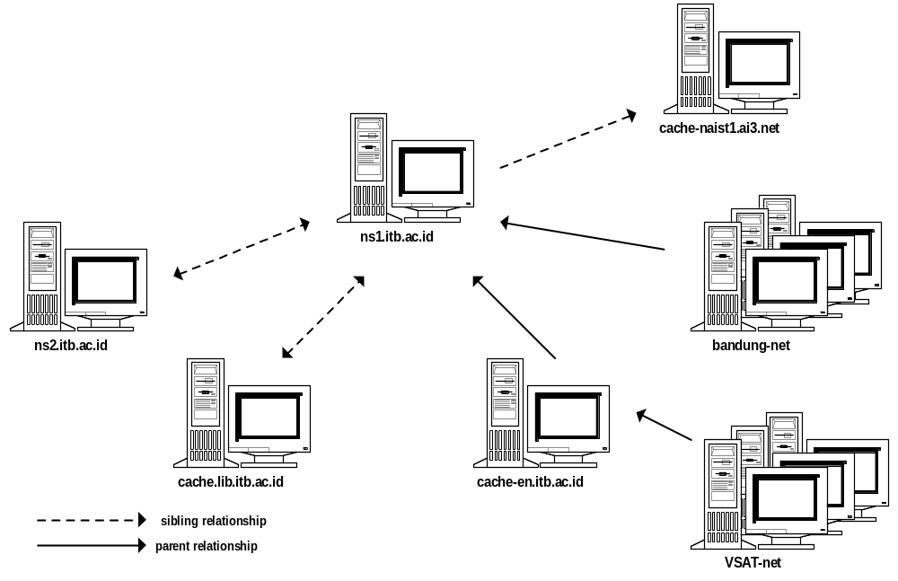
Cache Hierarchy at ITB Network

Slide 56
Cache Usage Monitoring
Log files
Daily statistics
Web-based report

Slide 57
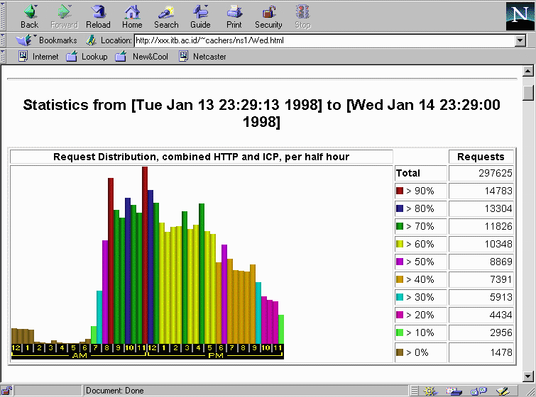
Cache stats: ns1.itb.ac.id

Slide 58
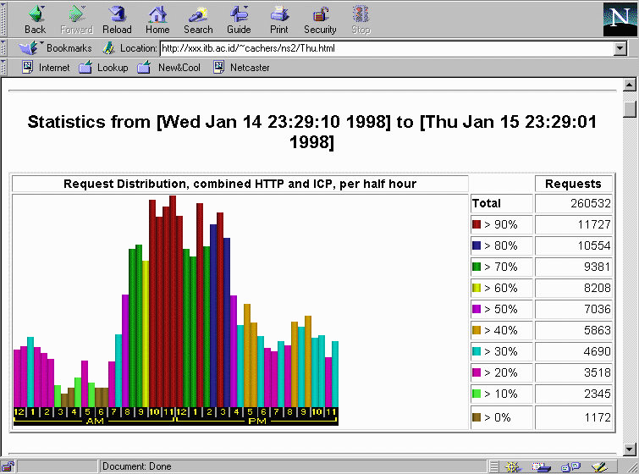
Cache stats: ns2.itb.ac.id

Slide 59
Results
Over 1.5Gbytes transferred data at a normal work-day
Over 400Mbytes transferred data at a weekend-day
Reduces upto 19% in HTTP traffic

Slide 60
Mailing Lists
Uses majordomo on FreeBSD
Run on Dual Pentium 166MHz 32Mb RAM.
More than 220 mailing lists at ITB. (more than 75% Indonesian mailing lists).
More than 10.000 subscribers.
We are trying to build the community in Indonesia.

Slide 61
Distance Learning
ITB’s Server:
  http://distance-courses.itb.ac.id/
  http://virtual-university.itb.ac.id/

Slide 62
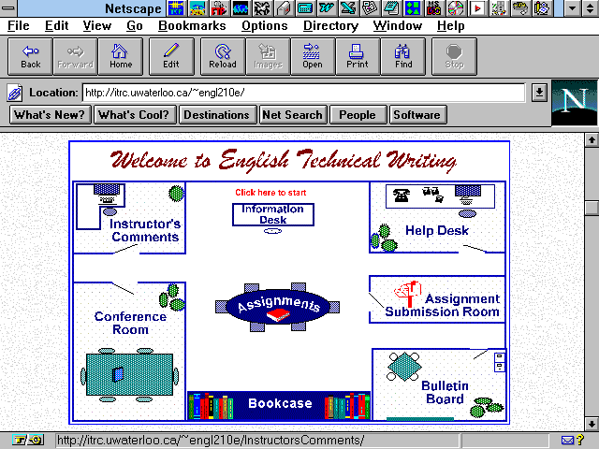

Slide 63
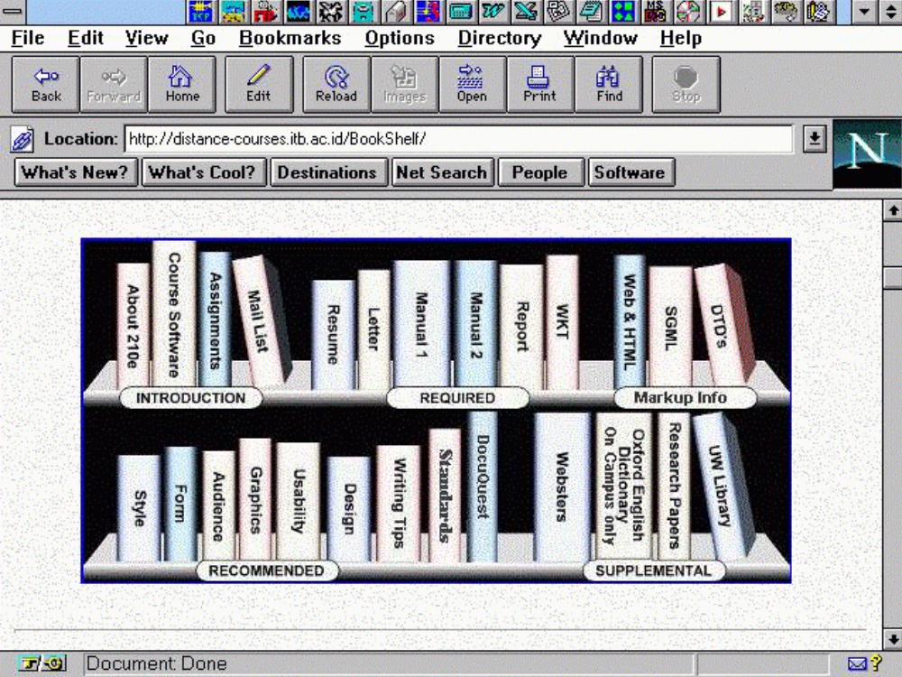

Slide 64
Video Conference
25 October 1997: 14:00 Indonesia Time.
Three Cities: Bandung-Surabaya-Malang
CU-SeeMe & Its Reflector.
Aiming for high school network in Indonesia.
July 1997: Panel Discussion on the future of higher education (UNU).

Slide 65
Video on Demand
Supported by Microsoft & Progressive Network.
Splitter for UNFCC COP3 December 1997.
Publisher for “ITB’s Alumny Congress” December 1997.

Slide 66
Summary
ITB has managed to integrate 20+ educational institutions to Internet.
Major IT used:
  2Mbps CDMA Network.
  Web based distance learning.
  Real Publisher / Microsoft NetShow.
Key to success:
    Mass Qualified Human Resource

Slide 67
References
http://ai3.itb.ac.id/
http://xxx.itb.ac.id/~yc1dav/
http://xxx.itb.ac.id/~cnrg/
http://xxx.itb.ac.id/~adnan/
http://distance-courses.itb.ac.id/
http://virtual-university.itb.ac.id/
http://netmon.itb.ac.id/
http://nic.itb.ac.id/

